Slide 1
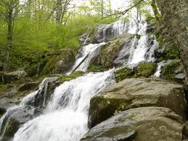
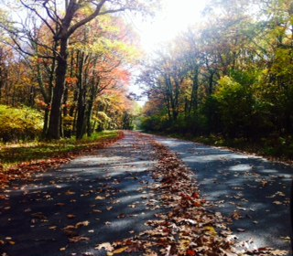
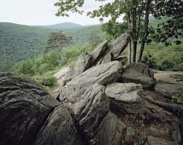
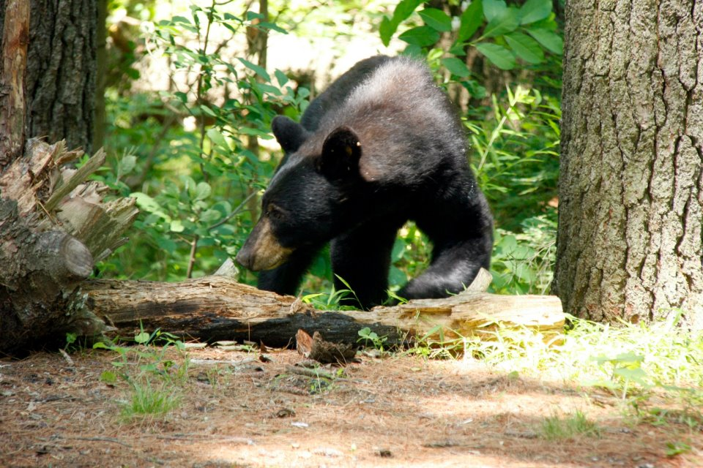
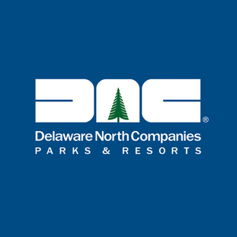
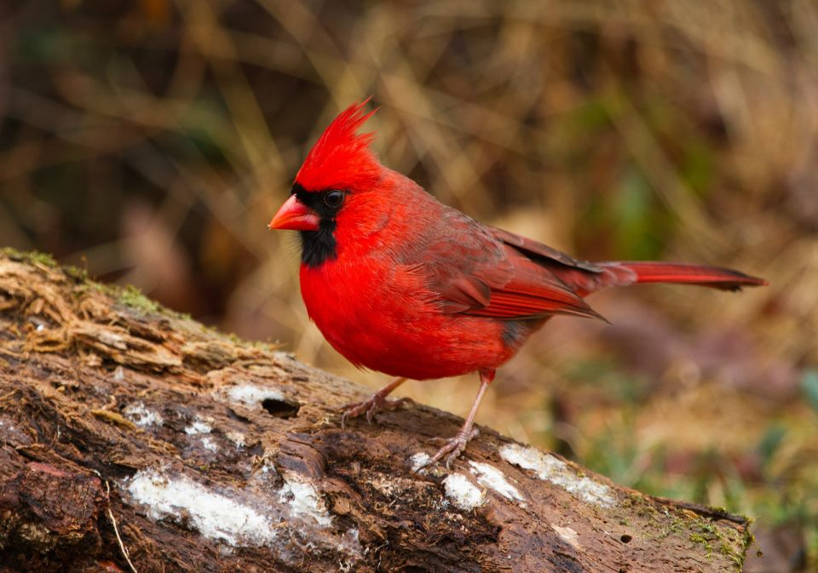
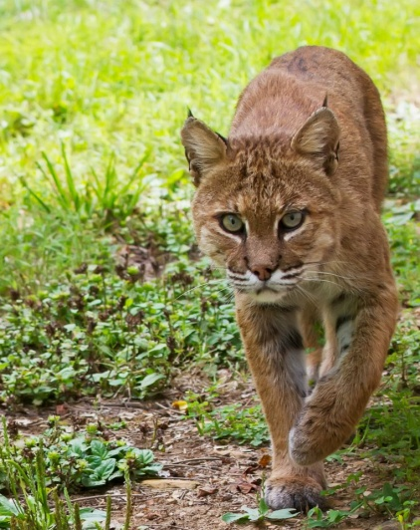
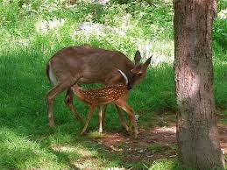
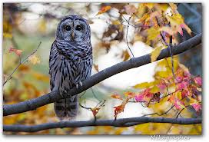
Delaware North Companies at Shenandoah National Park

Slide 2
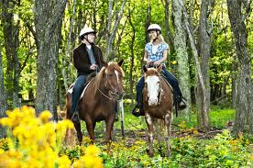
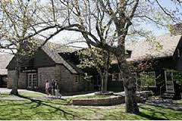
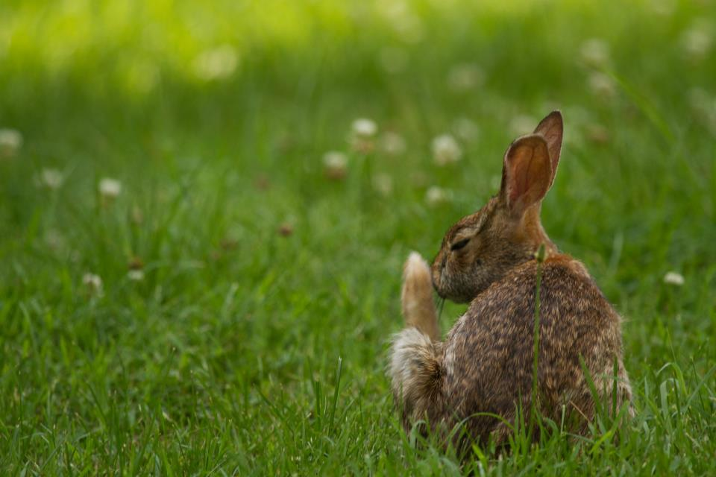
Shenandoah National Park
Shenandoah National Park encompasses 300 square miles of the Blue Ridge Mountains in the state of Virginia.
We are your escape to recreation. Cascading waterfalls, spectacular vistas, quiet wooded hollows—it’s a great place to hike, camp, bike, fish, and take photographs. It’s 200,000 acres of protected lands.
It’s home to many wildlife including over 50 different types of mammals, 39 fish species, 200 bird species, 51 reptile and amphibians species.
Our two highest peaks is 4,050 feet at Hawksbill and 4,010 at Stony Man.
We have over 1,400 types of plants throughout the park
Breathtaking views in every direction.
Skyline Drive noted as one of the top 10 most beautiful drives in the world.

Slide 3
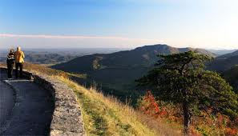
What do we do in Shenandoah National Park?
We operate:
Skyland Resort
Big Meadows Lodge
Big Meadows Wayside
Elkwallow
Lewis Mountain
Loft Mountain

Slide 4
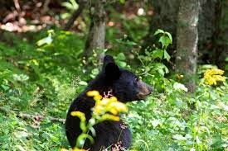
Skyland Resort
Skyland Resort Skyland (mile 41.7) has 179 guest rooms, rustic cabins, multi-unit lodges, and suites.
A restaurant, taproom, gift shop, rustic conference building and coffee/snack bar are located at the lodge.
Skyland offers guided horseback riding tours.
There are many spectacular views of the mountains and hiking trails everywhere.

Slide 5
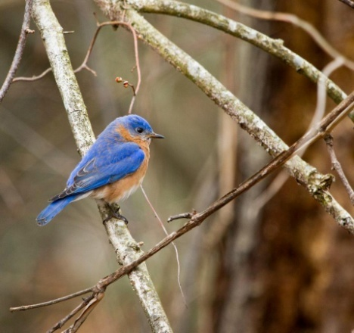
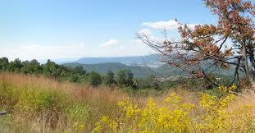
Big Meadows Lodge
Big Meadows Lodge Big Meadows (mile 51) has 25 rooms in the main lodge, 72 additional rooms in rustic cabins, multi-unit lodges, and suites.
There is a full service restaurant, a pub area, meeting room and gift shop –all located at the lodge.
The views are amazing. Trails are everywhere.

Slide 6
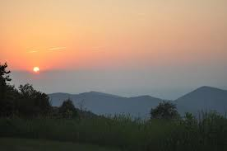
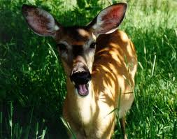
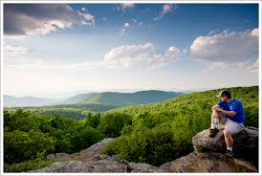
The Waysides
Elkwallow Wayside (mile 24.1) The Wayside offers a variety of breakfast selections and sandwiches and grilled items for lunch and dinner, with seating outside on the patio or at picnic tables.
Big Meadows Wayside (mile 51) The Wayside houses a full-service dining room with carryout service and offers a varied menu of regional favorites and contemporary food.
Loft Mountain Wayside (mile 79.5) The Wayside has a dining room with counter service, with seating inside and outside on picnic tables. The menu includes a variety of breakfast selections, sandwiches, and grilled items.

Slide 7
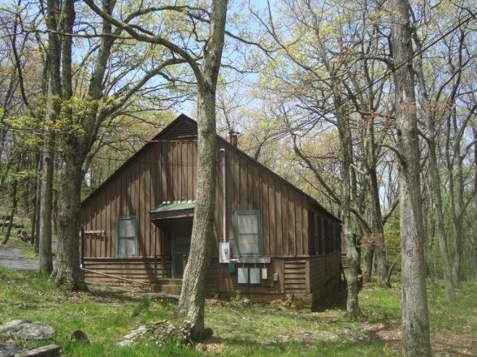
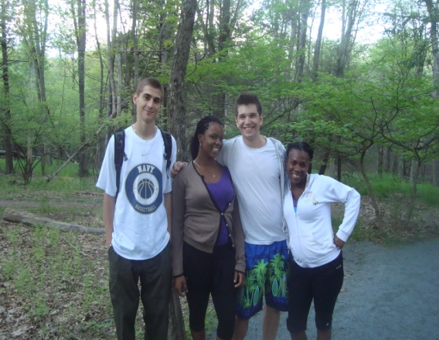
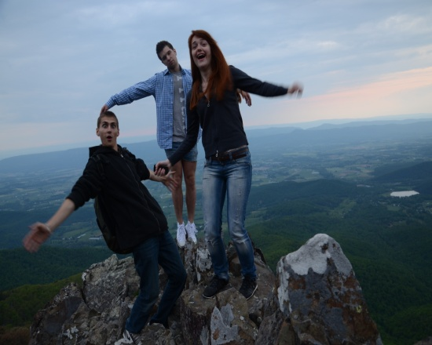
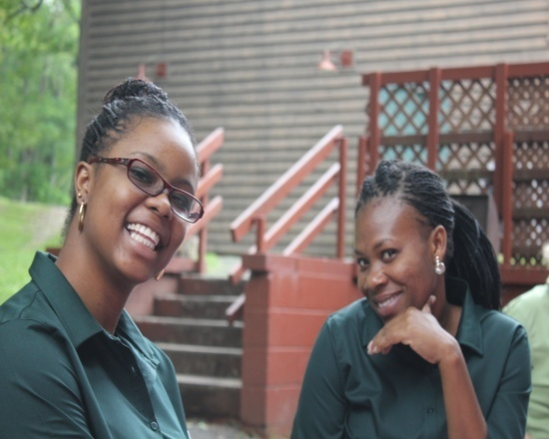
Living & Working in a National Park
We have approximately 320 associates that work throughout the Park and in our Luray, VA offices & warehouse. We hire associates of all ages, locally and from around the globe, including about 30 international students—each year.
Working in a National Park is an amazing experience. You meet and service guests from all over the world! It’s an experience like no other.
You will get to experience wildlife like no other place.
The views of your workplace are some of the most spectacular views around.
You receive discounts for you and your family to enjoy.
Delaware North Co operates Parks throughout the USA. Visit our website at www.DelawareNorth.com for more information.

Slide 8
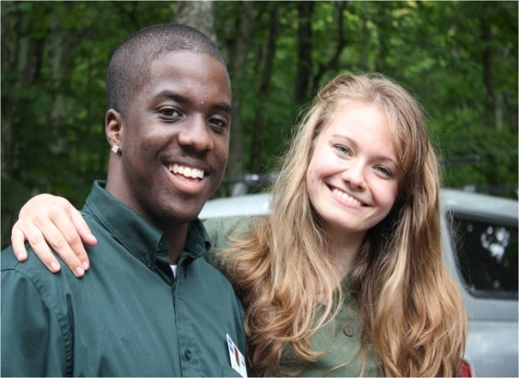
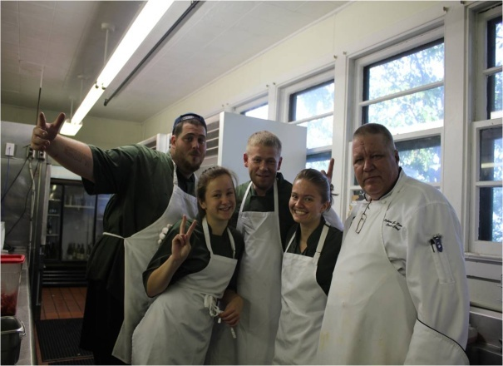
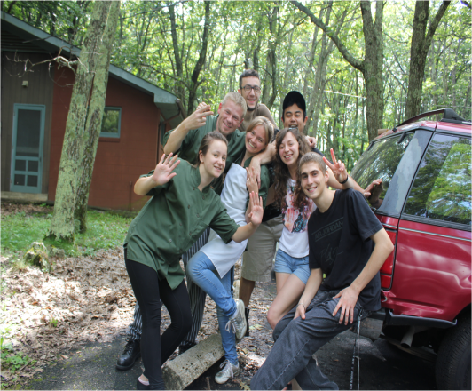
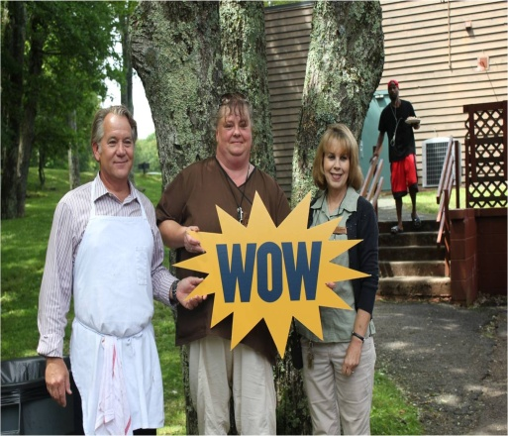
Living in the Park
Associates that live more than 45 miles from the Park can stay in our Dorms.
The dorms are located at Skyland and Big Meadows Lodge.
The rent is $25.00 per week.
A typical dorm houses between 2 and 4 associates. Each person is equipped with towels, washcloths, sheets and blankets. There are laundry facilities on-site.
Wi-Fi is available in the common areas and meals are available at discounted rates.
There is a fire pit available in the dorm areas and associates can participate in all of the events and activities available to guests at the Resort.
Some examples include: Horseback riding, self-guided hiking tours, rock climbing and rappelling programs, ranger programs.

Slide 9
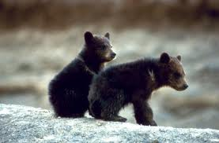
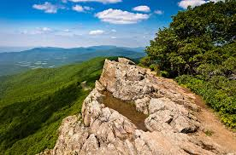
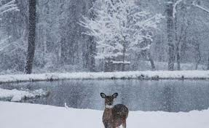
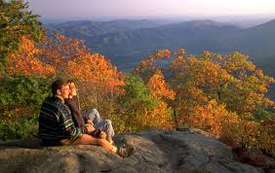
Our Seasons
We have 4 beautiful seasons in the Park. Skyline Drive is open, weather permitting, year around.
We normally open Skyland Resort in March—followed by the other properties—through the first of May.
We typically remain open for most properties through the first of November. Our Skyland Resort and Wayside with the gas station—stay open through the first of December.
Our Peak Season is October. That is when the fall foliage is at it’s most beautiful display of colors throughout the Park.
Visit our local website at www.goshenandoah.com for a list of our events and activities

Slide 10
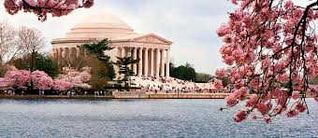
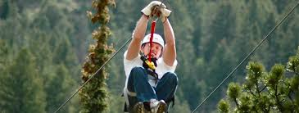
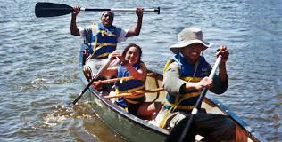
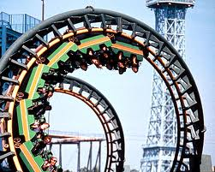
Activities around the Park
Shopping – several town malls and shopping stores in close vicinity: Luray, Harrisonburg, Charlottesville, Front Royal and Winchester.
Zoo’s in Luray, at the Smithsonian in Washington DC and at The Natural Bridge Zoo
Theme Parks of all kinds. Massanutten Water park, Kings Dominion, Six Flags and Busch Gardens.
Zipline tours across the mountain in Luray Va
Golfing—several courses in Luray, Harrisonburg and Front Royal.
Canoeing & tubing in Luray and Front Royal
Caverns in Luray and surrounding cities
Washington D.C (Our Nations Capital—only 75 miles from the Park)
Beaches –Virginia Beach is only 183 miles from the Park.

Slide 11
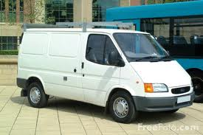
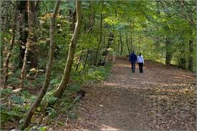
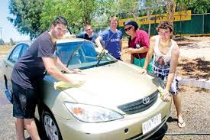
Transportation Options while in the Park
Your own vehicle is permitted in the Park
Rideshare with friends & co-workers
Taxi services
Luray VA
Scheduled trips to the different locations daily—see the Front Desk for more information
Your work location is walking distance from the dorm area

Slide 12
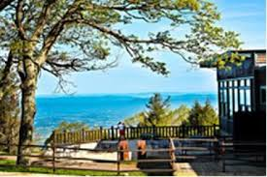
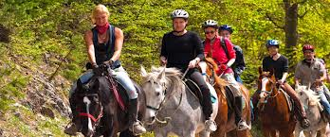
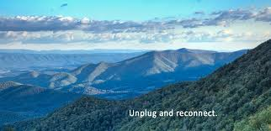
How do I become a part of the Team?
Complete an application for employment. You can obtain this from the following resources:
CoolWorks.com
www.goshenandoah.com
Send an email to: Pwightma@dncinc.com
Call 540.843.2100

Slide 13
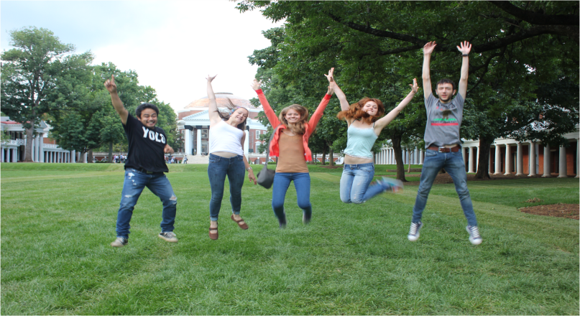
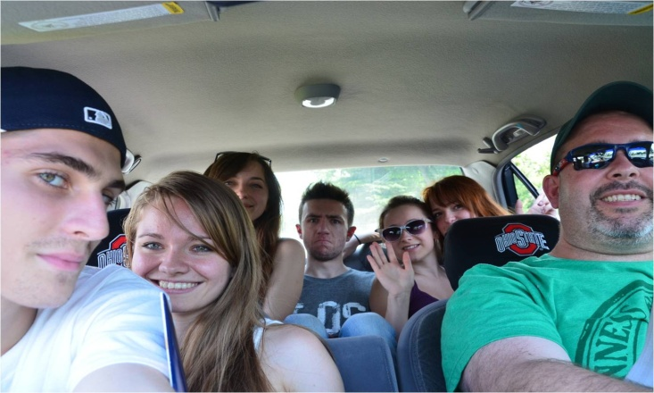
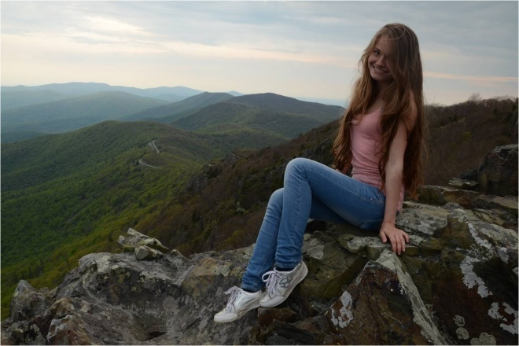
Summary
Working in a National Park is a once in a lifetime experience.
If you love nature—and enjoy spending your summer living in a remote area with the hustle and bustle of our regular lives just a few short miles from there—this is the place for you.
We are hiring cooks, housekeepers, servers, hosts, wranglers, front desk clerks and warehouse workers.
We look forward to your application!

